Slide 1
TQAI - Social Media Agent
Revolutionizing Content Creation & Competitor Monitoring
Harnessing AI to Create Social Media Posts and Track Competitors

Slide 2
Agenda
Why is Social Media so important?
Key Features of the Social Media Agent
How it works?
Benefits to Users
Use Cases
Demo
Technology Behind the Social Media Agent

Slide 3





Why is Social Media so important?
1. Brand Awareness
2. Customer Engagement & Relationship Building
Good or bad, we know how important social media is nowadays in our personal lives but not just. The image of a company is crucial for its growth. In short, social media is a powerful tool that allows businesses to grow, engage, and maintain relationships with their audience. It’s a critical part of any modern marketing strategy, whether you’re trying to build brand awareness, drive sales, or manage customer relationships.
3. Increased Sales & Leads
4. Building Credibility & Trust
5. Competitor Analysis

Slide 4
Automated Content Creation from URLs
Extracts relevant data from a webpage or blog.
Generates compelling social media posts.
Adapts content for different platforms (Twitter,Linkedin)

Slide 5
YouTube Video Content Integration
Analyzes YouTube videos for key insights.
Creates optimized post captions, hashtags, and from video content.
Allows users to repurpose video content for social media promotion.

Slide 6
Competitor Monitoring
Tracks competitors’ social media activity and engagement.
Analyzes trends, keywords, hashtags, and popular content.
Provides insights to adjust your social strategy in real-time.

Slide 7
How it works?
Scheduling and Posting
Step4
Agent Content Generation
Step3
Agent Data Extraction
Step2
Step1
Input content URL or
YouTube Video URL

Slide 8
Benefits to Users
Efficiency and Time-Saving.
Automates repetitive tasks like content creation and competitor monitoring.
Enhanced Social Media Strategy.
Ensures content is always fresh, engaging, and optimized for platform algorithms
Competitor Insights.
Helps identify gaps in your strategy and leverage competitor strengths.
Improved Engagement and Reach.
AI-generated content tailored for each platform increases interaction and visibility.

Slide 9
Use Cases
Brands and Agencies:
Automate content creation for multiple clients or campaigns
Influencers:
Simplify content creation and tracking of competitor strategies to stay ahead of trends
E-commerce:
Create targeted, engaging posts from product data or video reviews
Media & News Outlets
Repurpose articles and videos into engaging social media content

Slide 10
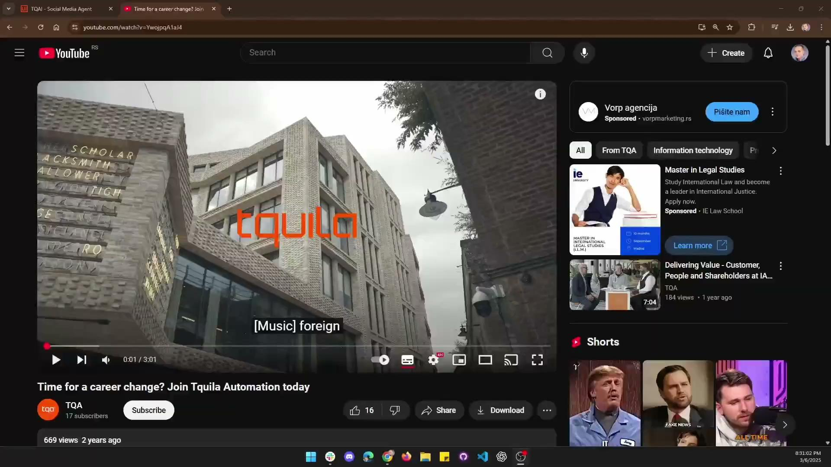
See it in Action

Slide 11


Technology Behind the Social Media Agent
GenAi
UiPath Agent Builder
UiPath Studio Web
UiPath Studio Desktop
UiPath Apps
OpenAi gpt-4o-2024-05-13
JinAi Scraping Engine

Slide 12


Q&A

Slide 13
Thank you
Bogdan Jianu – bogdan.jianu@tqasolutions.com
Bogdan Todic – bogdan.todic@tqasolutions.com
Dragos Padurariu – dragos.padurariu@tqasolutions.com
Flavius Serban – flavius.serban@tqasolutions.com
Georgiana Manea - georgiana.manea@tqasolutions.com

